Slide 1
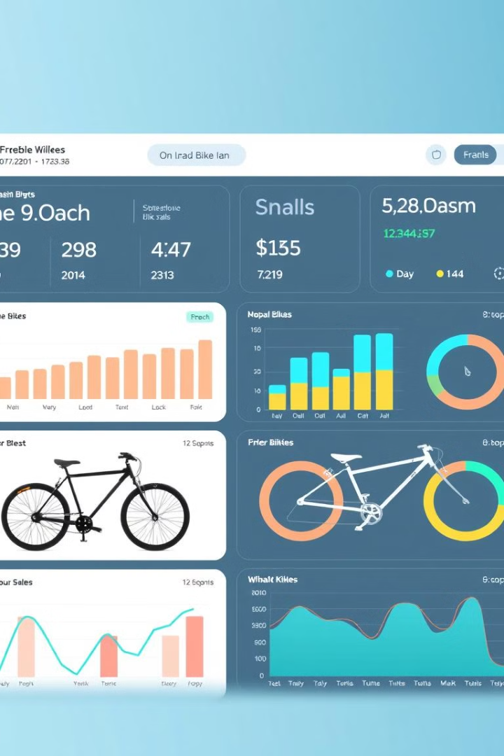

Bike Sales Analysis: Insights and Trends
A data-driven approach to understanding market performance.
by sharath y

Slide 2






Agenda
Introduction
Dataset Overview
Key Insights
Visualizations and Dashboards
Recommendations
Conclusion

Slide 3

Introduction
Uncover trends in bike sales, resale values, and customer preferences.

Slide 4
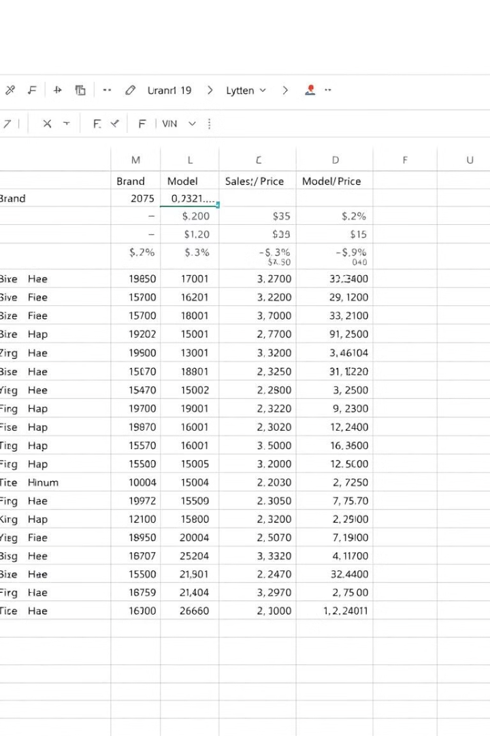
Dataset Overview
State
Brand
Model
Price
Fuel Type
Delhi
TVS
Jupiter
1,14,500
Petrol
Mumbai
Hero
HF Delux
75,800
Hybrid

Slide 5

Key Insights
1
Higher Mileage
2
Electric Bikes
Lower resale values.
Gaining popularity in Tier 1 cities.
3
Brand Bajaj
Highest average resale price.

Slide 6
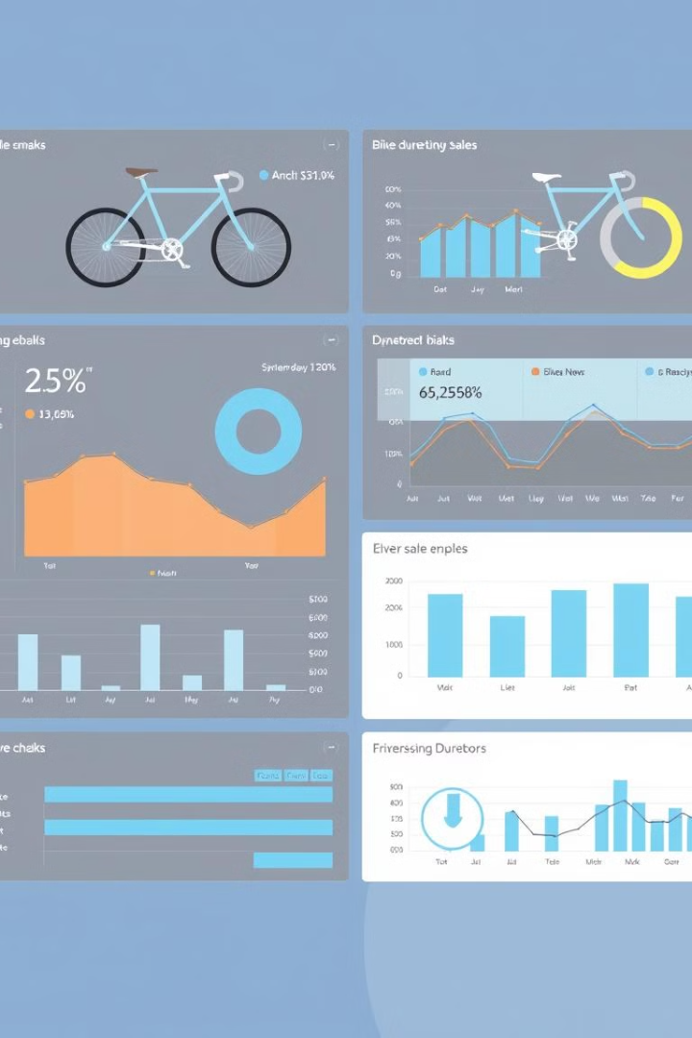
Visualizations and Dashboards
Interactive charts for resale price trends, mileage analysis, and regional sales performance.

Slide 7
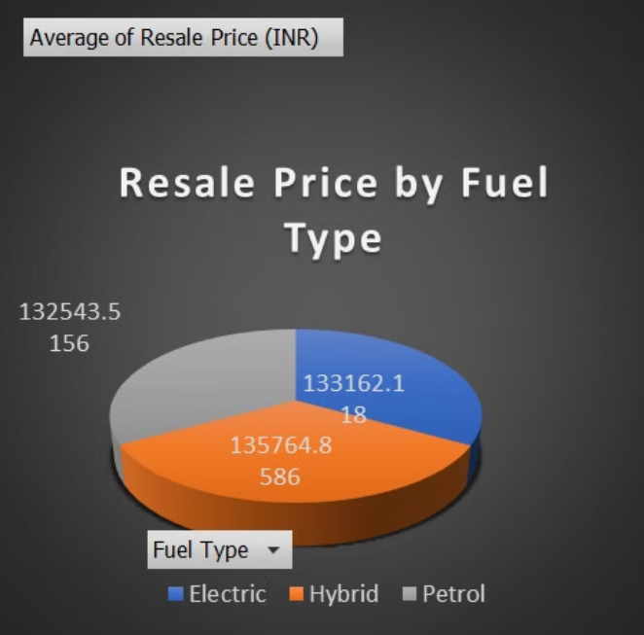
Resale Price Analysis

Slide 8
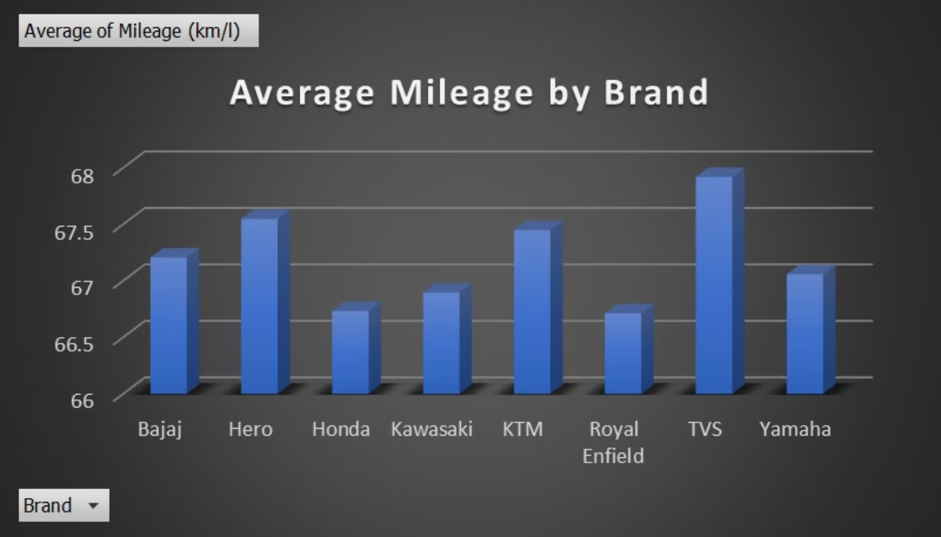
Mileage By Brand

Slide 9
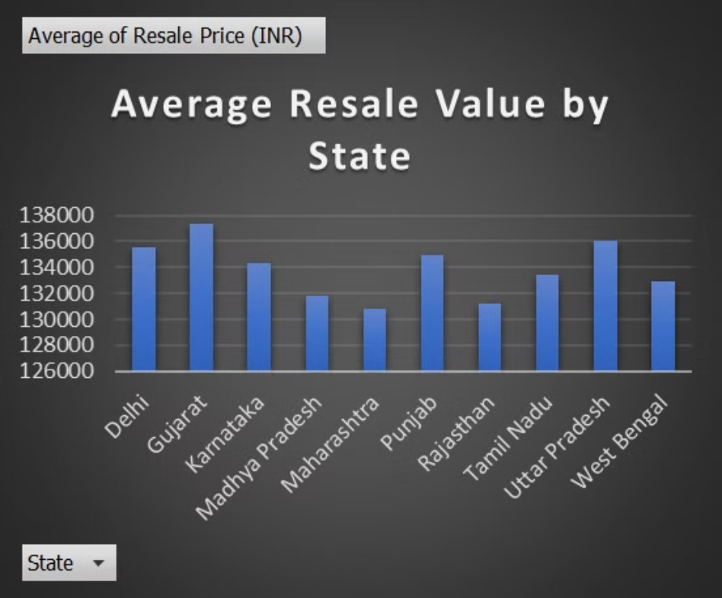
Resale Prices by State

Slide 10
Key Takeaways & Future Directions
Mileage significantly impacts resale value.
Electric bike popularity is growing, especially in urban areas.
Brand perception plays a crucial role in resale pricing.
Further analysis: Customer segmentation and market forecasting.

Slide 11
Thank You
Thank you for your time and attention.
Authored by Sharath Yelle

